Slide 1
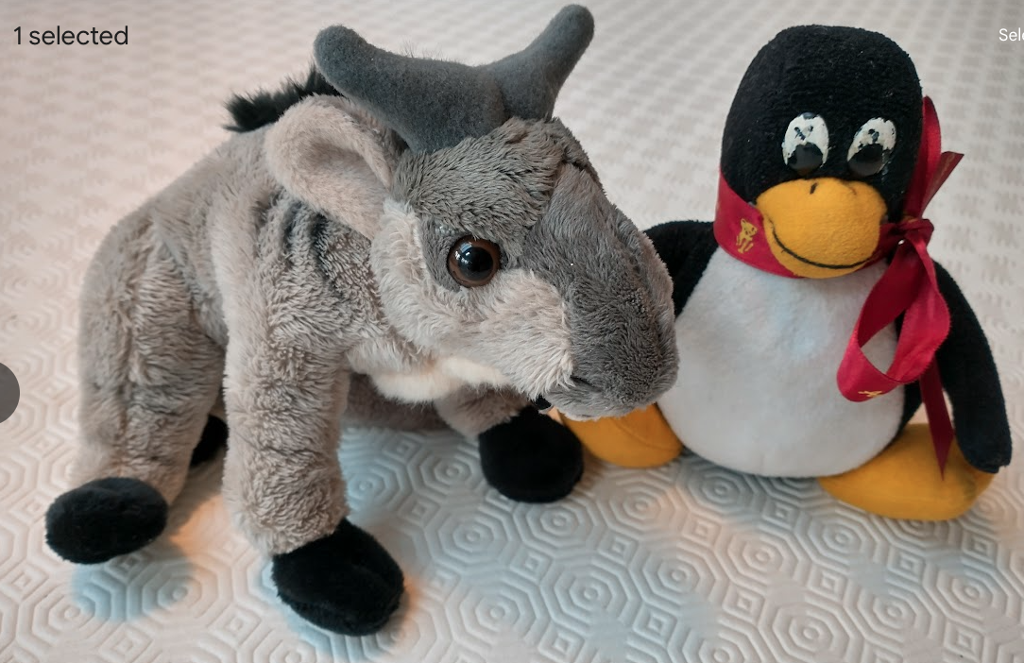
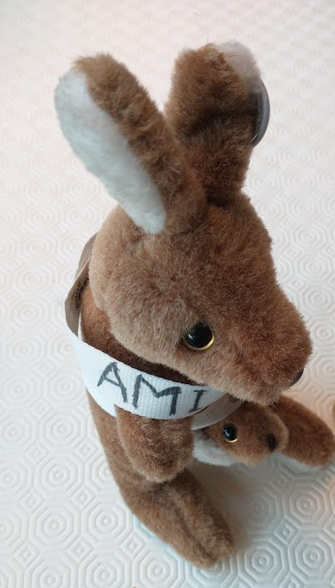
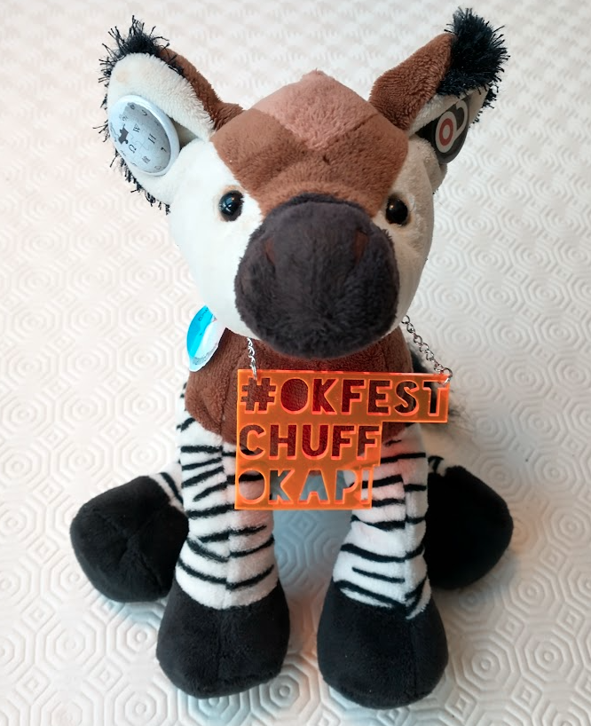




semanticClimate’s knowledge graphs
Peter Murray-Rust
University of Cambridge semanticClimate
Peter.murray.rust@googlemail.com
FOSDEM, Brussels BE, 2025-02-01
NIPGR team
Volunteers
TIB Germany
https://semanticclimate.github.io/p/en/posts/resources/
We’ll guide you through the presentation
Free and Open Source (F/OSS)
And show some videos
Chuff the OKF Okapi
AMI, semanticClimate

Slide 2
WE’RE DEADLY SERIOUS!
What are we going to see?
Overview of semanticClimate …
Intern presentations …
Live/online Demos
This is NOT a “student project”. We’re semantifying “the survival guide for humanity*”
Because nobody else yet is doing it
Not available in any
Indian languages
https://www.bbc.com/news/science-environment-65000182 *

Slide 3
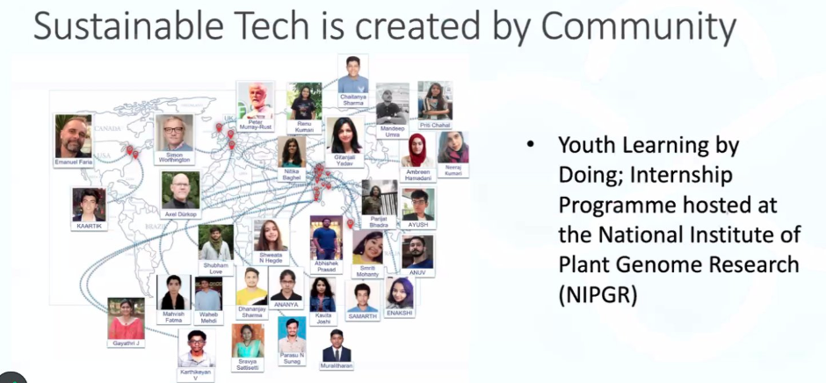
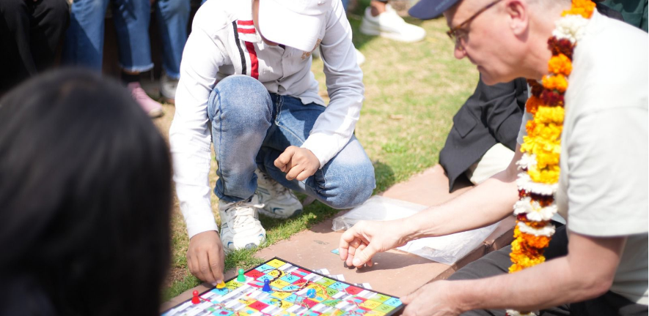
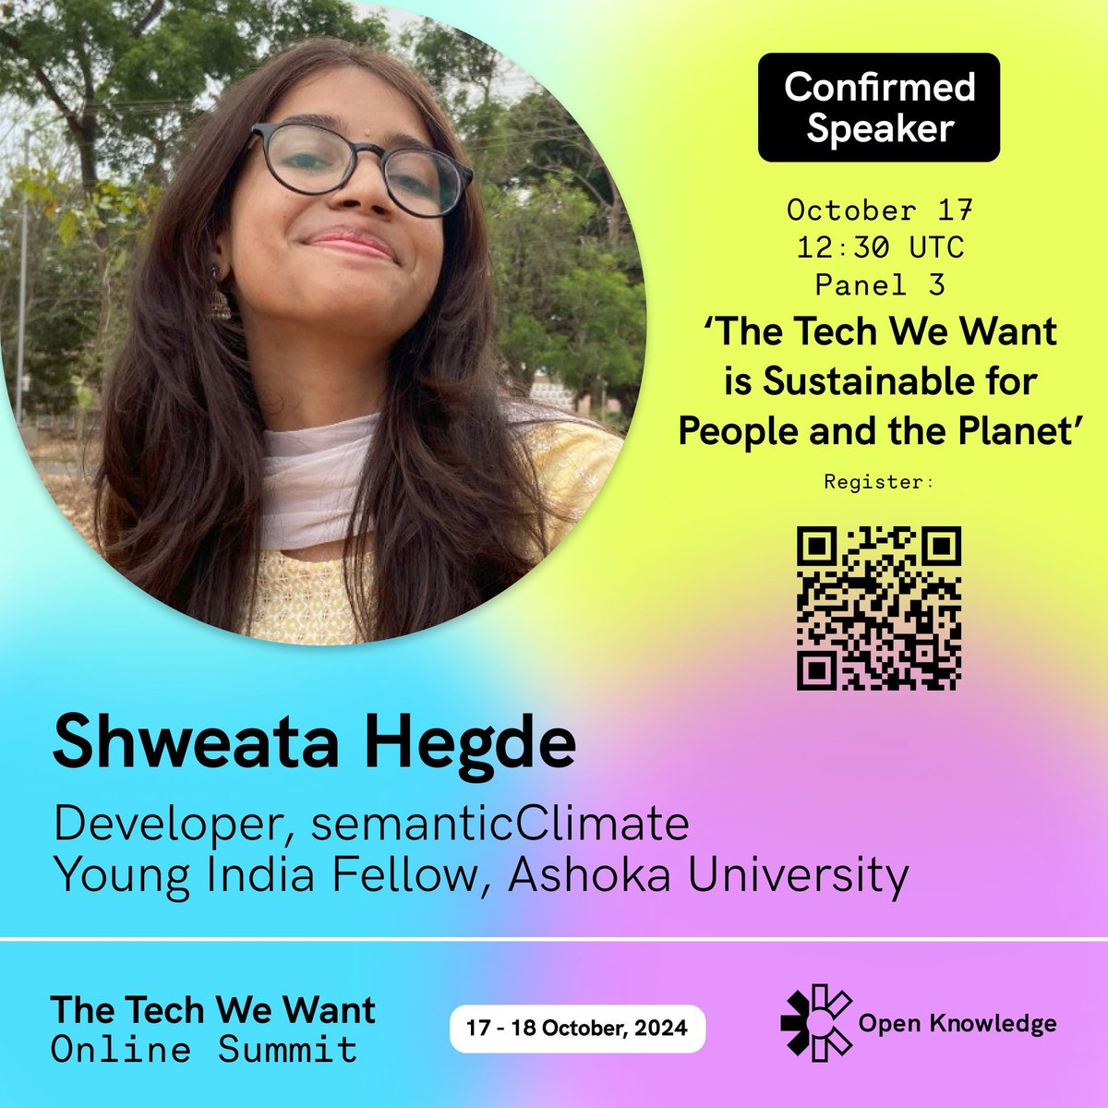
semanticClimate
Builds a community
Automatically collects climate information , makes it semantic, annotates it:
for learning, re-use and advocacy by everyone

Slide 4
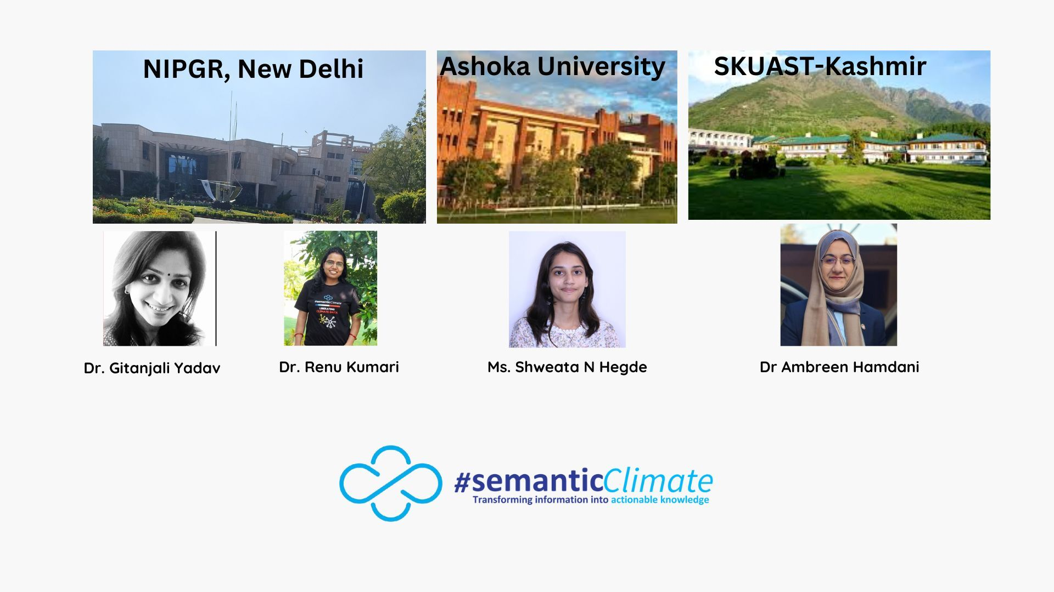
Mentors and Support
“Doctor WHO
handover”
Simon Worthington: TIB Hanover (German National Library of Science and Technology:
Leibniz Information Centre for Science and Technology and University Library)
2020-current; and 100+ participants
6-monthly internships (thanks NIPGR)
https://blogs.ch.cam.ac.uk/pmr/2009/06/06/the-doctor-who-model-of-open-source/

Slide 5
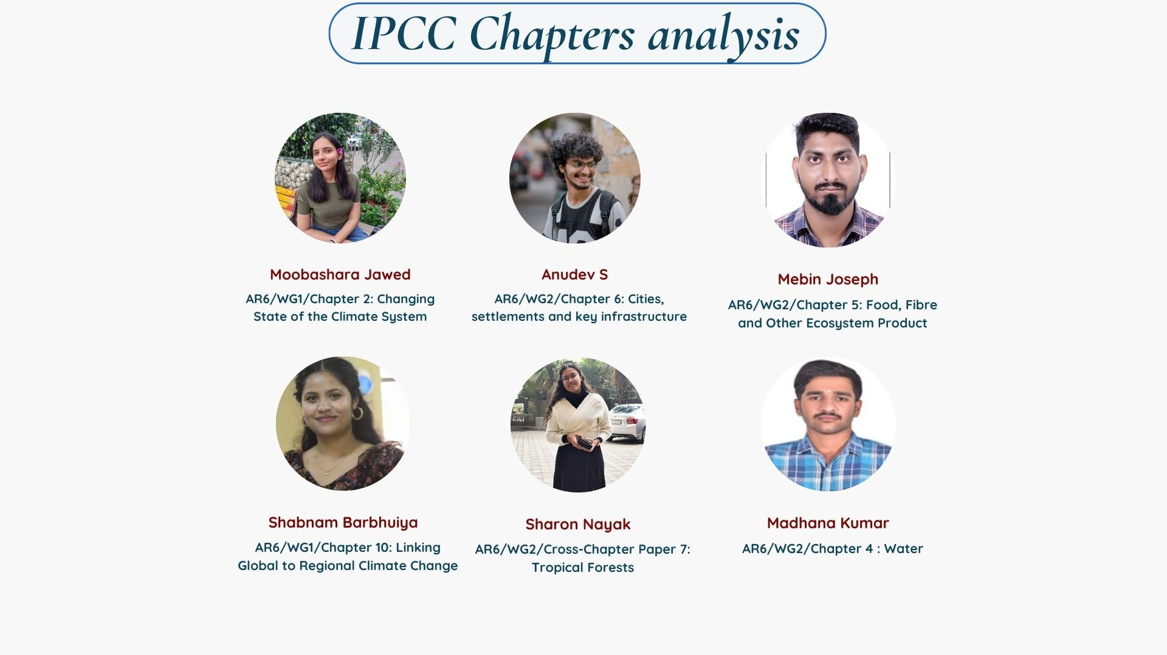
They joined in January 2025
AMI
Sharon will be presenting!

Slide 6
"Learning-by-Doing”
Driven by public presentations!
new joiners often have no previous coding

Slide 7
Presentations from OKF “TheTechWeWant 2024”
Shweata and Parijat describe IPCC; how to make it semantic
Enshittification alert! There may be YouTube ads
https://www.youtube.com/watch?v=o50Jd1w6xKw&t=16842s&ab_channel=OpenKnowledgeFoundation (Shweata N Hegde)
https://www.youtube.com/watch?v=V7Sxo0IXe8g&t=7800s&ab_channel=OpenKnowledgeFoundation (Parijat Bhadra)

Slide 8
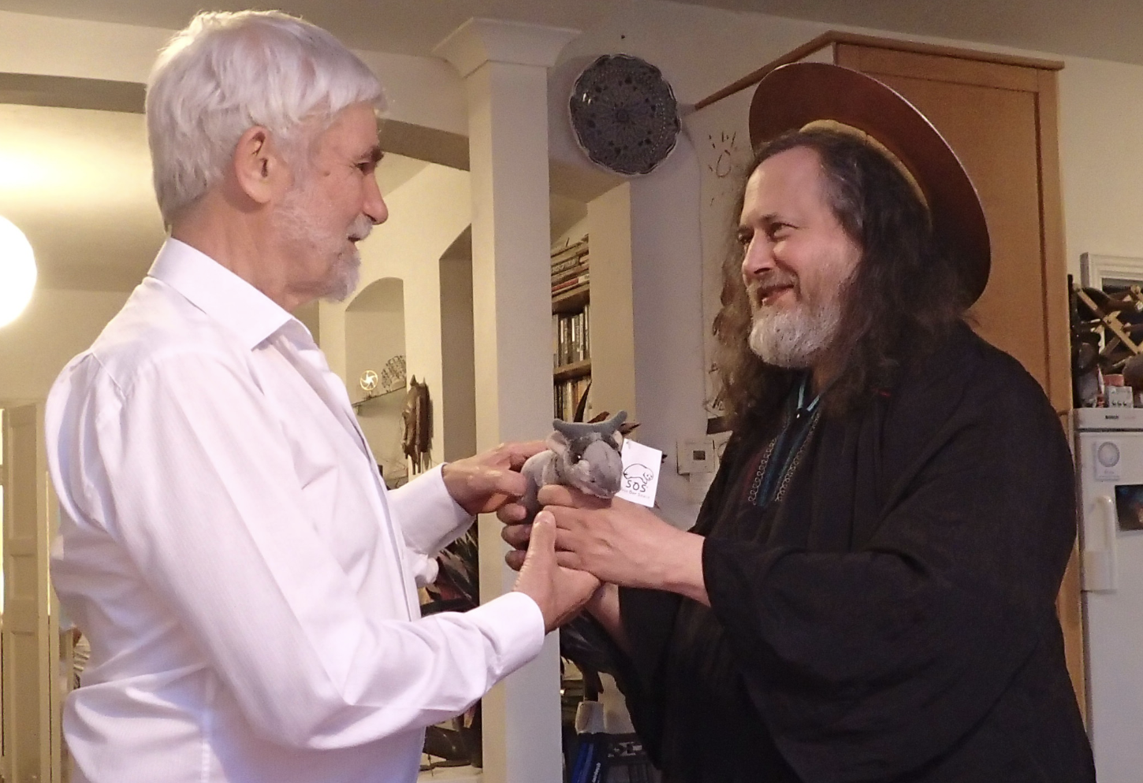
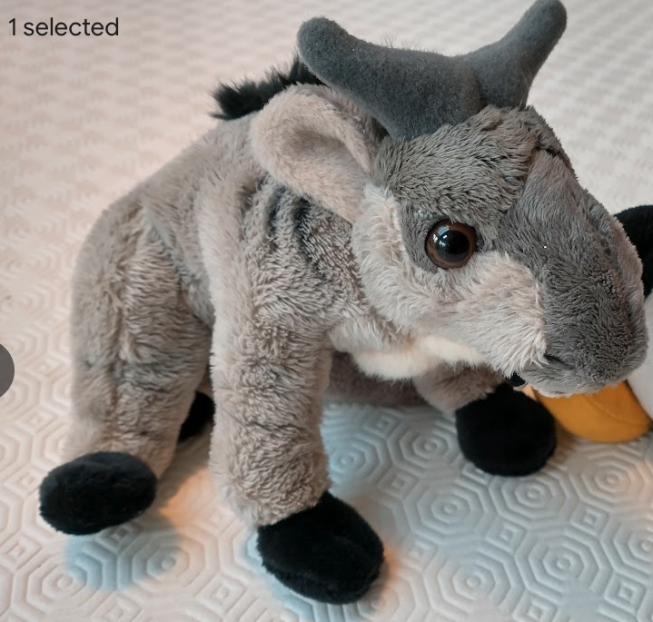
Software freedoms
0. to run the program for any purpose
1. to study how the program works (source code )
2. to redistribute copies so you can help your neighbor.
3. To distribute copies of your modified versions
https://en.wikipedia.org/wiki/The_Free_Software_Definition
GNU
https://blogs.ch.cam.ac.uk/pmr/2014/07/01/visit-of-richard-stallman-rms-to-cambridge/

Slide 9
Our mission
To create verifiable computable climate knowledge
we take the following as verifiable sources of truth
IPCC framework (PDF or web-HTML)
UNFCCC reports (COPs)
1000/week scholarly climate publications

Slide 10
What’s in the IPCC material?
IPCC website (PDF or web-HTML)
3 Working Groups (WG1, WG2, WG3)
several Special Reports
Synthesis Report
15000+ bibliography
700-term Glossary
1500 acronyms
maps, data, etc.
We make all of these semantic (machine parsable into structured, annotated data). Total:
20,000 pages of PDF => HTML
1000 figure captions
It’s HUGE!

Slide 11
Knowledge Graphs
our approach is very simple
no OWL, no Protege
RDF triple
node-edge-node
Wikidata!
It’s an enhanced triple Store

Slide 12
Graph Visualization and Analysis
We’ve many tools...
editors and display
networkX
D3
query languages…
SPARQL
GraphQL

Slide 13
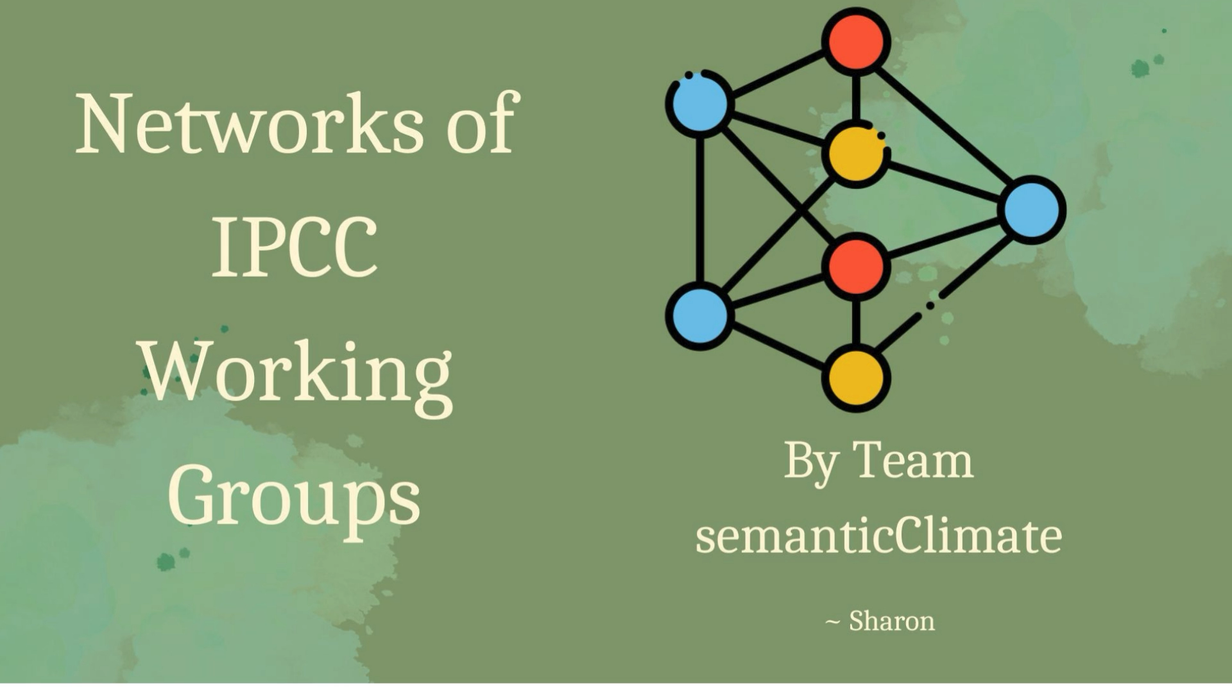
Sharon demonstrates network and a ToC graph

Slide 14

Linked OpenData
100 million items
Dictionaries
Documents

Slide 15
Renu’s go-to page of sC Resources https://semanticclimate.github.io/p/en/posts/resources/
Glossary/Encyclopedia (700-2000 IPCC terms) (SimonWorthington)
Knowledge Graph of the IPCC glossary (ShweataHegde)
Wikidata Knowledge Graph of a section of SYR (IPCC Synthesis) (Egon Willighagen)

Slide 16
OUTREACH Past events Shweata and Parijat Bhadra at “The Tech we want” 2024 ISOSC CODATA 2023 many short videos Renu’s page of videos Upcoming event OKFN ORDEM (Shweata and Ambreen) Feb 15 2025 we'd love to Scale up knowledge graphs Find new users make our terminology available find new volunteers (climate, IT, languages) Build tested libraries Have a look at our resources!

Slide 17
Thanks to: * Yusuf Hamied Travel Fellowship (Cambridge India)
NIPGR Hosting and internships
Indian National Young Academy of Scientists
Egon Willighagen
Wikimedia
The brave people who have challenged injustice

Slide 18
End of Presentation
(some random pages about AI follow)

Slide 19
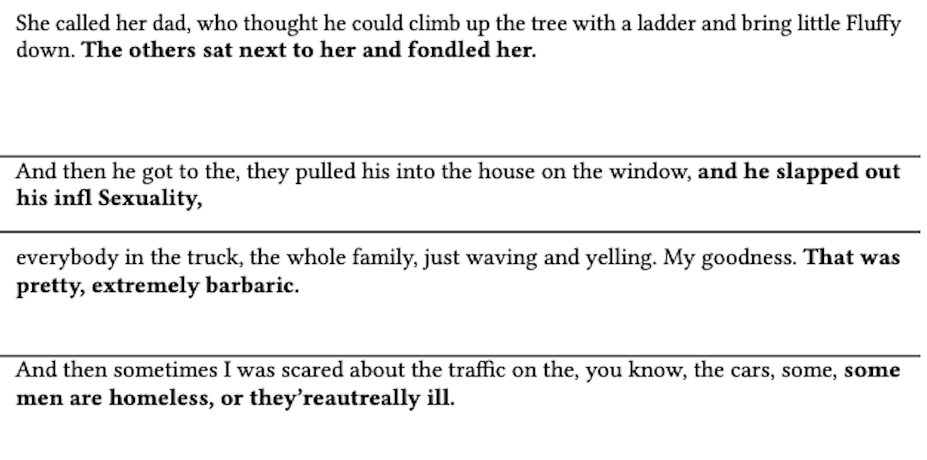
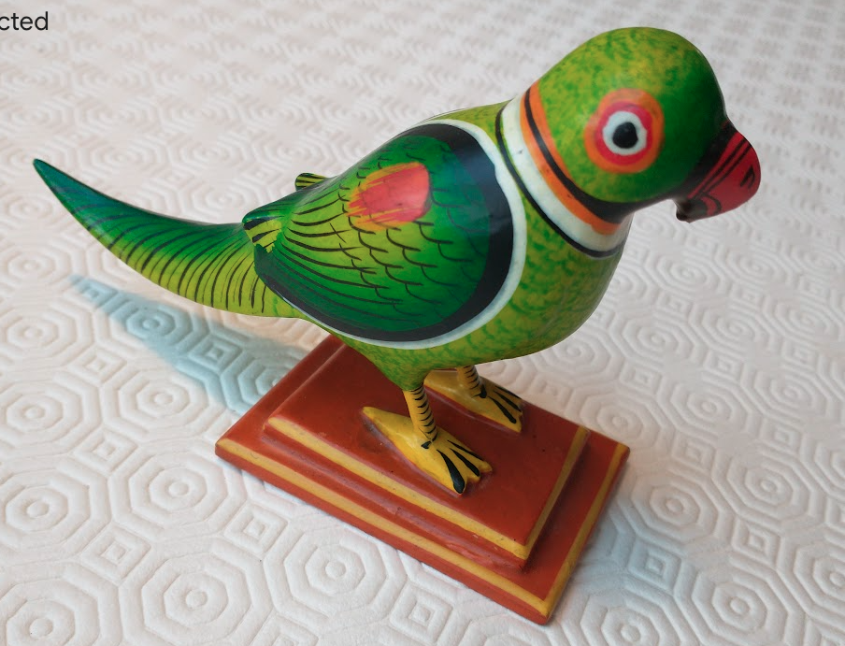
Hallucinations!
Polly,
stochasticParrot

Slide 20
Should we trust HuggingFace?
I don’t know where their data comes from
And they don’t have an advisory board
AMI, semanticClimate
We must create our own OKF-Open framework!

Slide 21
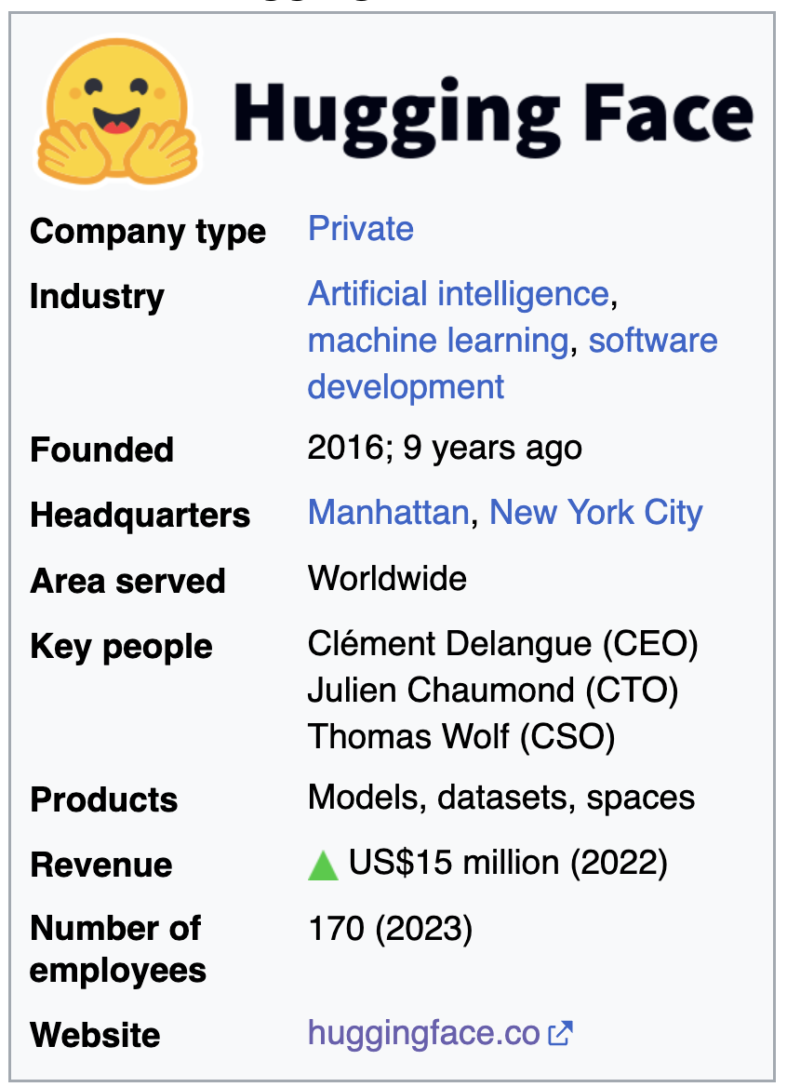
the data are private,
run by a private for-profit company
“We are on a mission to democratize good machine learning, one commit at a time.”

Slide 22
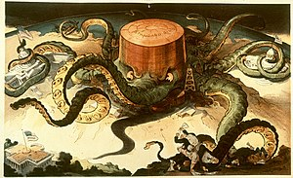
ROBBER BARONS
1904 depiction of an acquisitive and manipulative Standard Oil (founded by John D. Rockefeller) as an all-powerful octopus
Those practices included
unfettered consumption and destruction of natural resources,
influencing high levels of government,
wage slavery,
squashing competition by acquiring their competitors to create
monopolies and/or trusts that control the market, and
* schemes to sell stock at inflated prices to unsuspecting investors.^{[2]}
Credit: Wikipedia

Slide 23
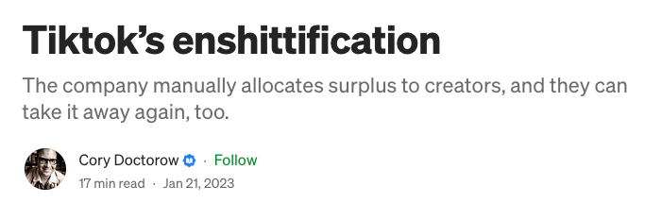
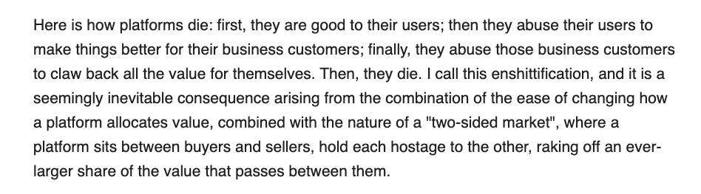
https://pluralistic.net/2023/01/21/potemkin-ai/#hey-guys

Slide 24
Engage your brain! Control AI or it will control you!
AMI, semanticClimate

Slide 25
https://x.com/okfn_okapi

